Slide 1
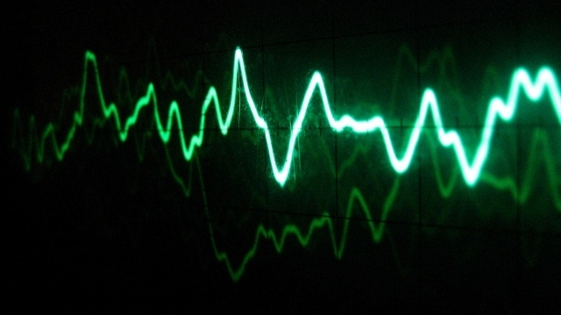
Application of Statistics in Digital Signal Processing
Presentation by Group 11:
Parth
Shaan
Nikhil

Slide 2

Introduction
A signal is the description of one parameter with the other. For eg. in analog electronics variation of voltage with time. If both parameters assume a continuous range of values then it is called as continuous signal otherwise discrete signal. In electrical engineering mostly the x-axis (independent variable) is the time domain or the frequency domain while y-axis has the voltage value(dependent variable). It’s quite natural to ask now what is the average value of my signal and how much it is dispersed. This is addressed by calculating the mean of the voltage and standard deviation respectively. Since signal generated from natural process such as heartbeat or audio processing contain a lot of noise from surroundings, due to instru- ment faults or due to random errors comes the concept of underlying process and acquired signal. This can be understood from an example: Consider flipping a coin 1000 times. The process that created this experime- nt suggest that occurence of head and tail is 0.5 each but it’s highly unlikely to get 500 times heads and tails. Process is the underlying distribution while the data recorded is the acquired signal.

Slide 3
Why do we need statistics ?
Signal processing is the method of decoding information from physical observations. Most of the times, signals are subject to noise, which is an unwanted change in the actual waveform. The nature of noise is random and we can use statistics to device techniques for reducing it. Statistics can be used to create a model for the distribution of noise. Based on this, suitable filters can be designed to counter it and estimations can be made more accurately

Slide 4
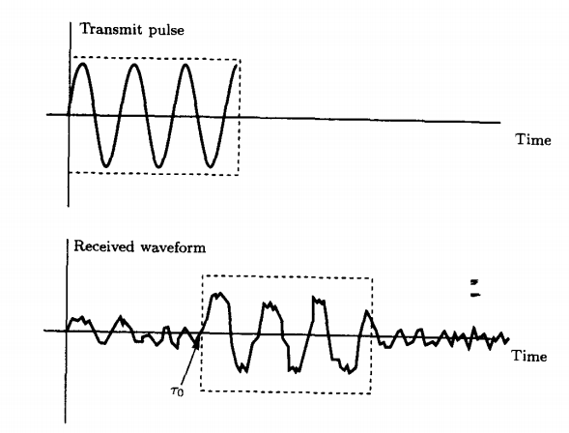
RADAR
Consider the example of RADAR systems In radar we are interested in determining an object’s position We transmit an electromagnetic pulse that is reflected by the object, causing an echo to be received by the antenna after some time delay(and knowing this delay is equivalent to knowing the position) However, the process of detecting a peak in the received waveform is not as easy as it sounds, since the received waveform also contains a lot of noise. This noise distorts the signal shape and determining the ‘start point’ of the received signal is a problem of estimation. Thus statistics is an important tool in signal processing

Slide 5
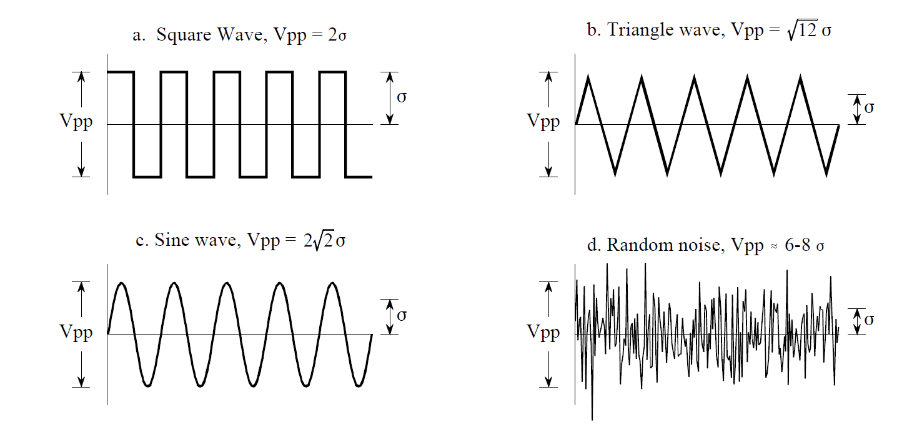
Mean and Standard Deviation
Given are few examples of signals with their amplitude (Vpp/2) and standard deviation (σ²):
Mean(μ) = (Σ xᵢ)/N.
Standard Deviation(σ²) = (Σ(xᵢ - μ)²)/N
We may note here that for continuous signal summation changes to integral.

Slide 6
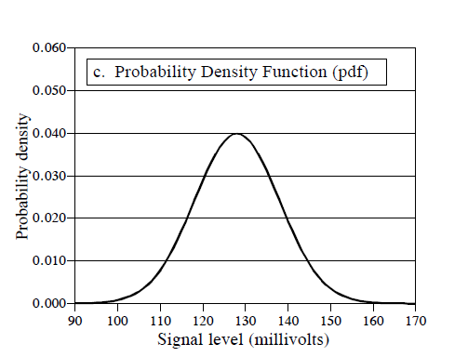
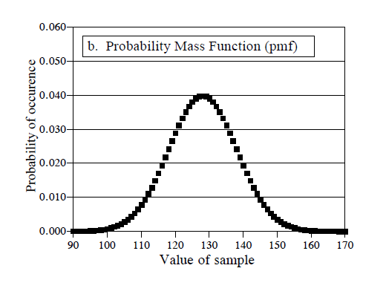
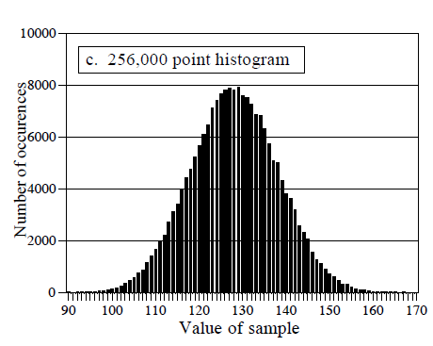
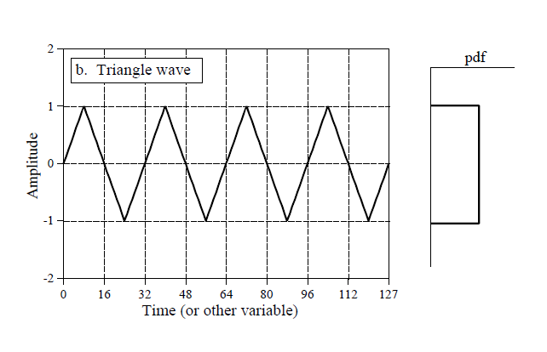
Histogram, PMF, PDF
Histogram: It tells us the number of occurence of a particular value of signal in our acquired data.
PMF: Its made for the underlying process hence its continuous.
PDF: Its same as a PMF but for continuous signal.

Slide 7
Statistical Noise
We saw the concept of underlying process and acquired signal. The irregularity in the actual data is known as statistical noise or statistical fluctuation. In literature we find that typical error in calculating the mean of the underlying process is given by:
Typical error = σ/N^0.5
What we see here is a manifestation of strong law of large numbers which says that as number of samples tends to infinity the error in estimation of mean goes to zero. But if the samples are finite we have to account for statistical noise.

Slide 8
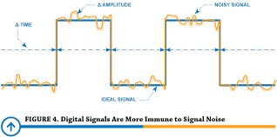
Applications of Statistics
Moving Average Filters.
Digital Noise generation.

Slide 9
Moving Average Filters
As the name implies, the moving average filter operates by averaging a number of points from the input signal to produce each point in the output signal. In equation form, this is written:
y[i] = (Σx[i+j])/M
where y[i] is the output signal, x[i] is the input signal, M is the numbers of sample points for average and j is the summation variable which goes from j=0 to M-1. This expression could be seen as convolution on x(input signal) using a simple kernel ...0, 1/M..(M times).. 1/M, 0… . Now our brain questions what is this convolution???

Slide 10
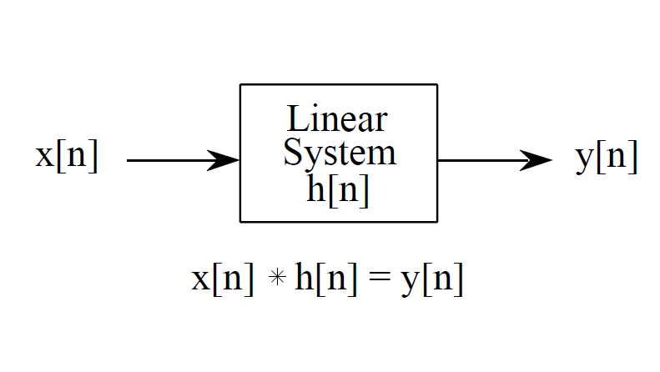
Convolution
Convolution is just a mathematical operator such addition or multiplication. Addition takes two numbers and produces a third number, similarly convolution takes two signals operates on them and produces a third signal. One signal is called as input signal, one is called as kernel and lastly the output signal. A typical eg. of a kernel is the e^{−st} used in laplace transform. It’s just a function which gets multiplied by the input signal and then some operation such as integration is carried out on a specific domain to give the output signal.

Slide 11
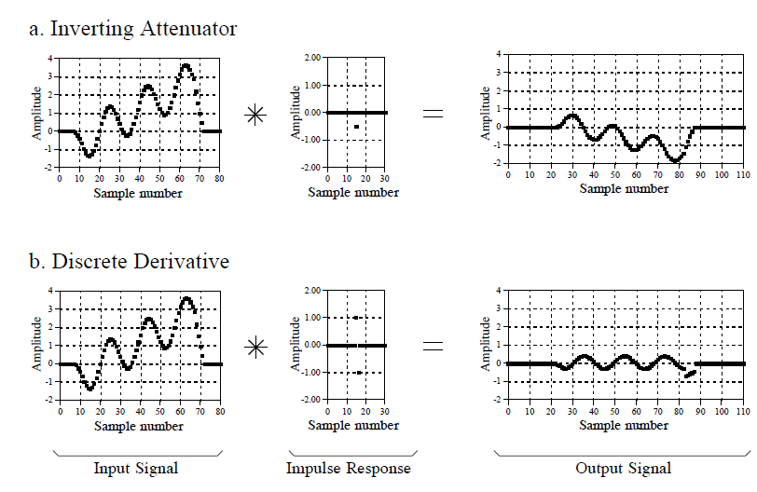
Examples of Convolution

Slide 12
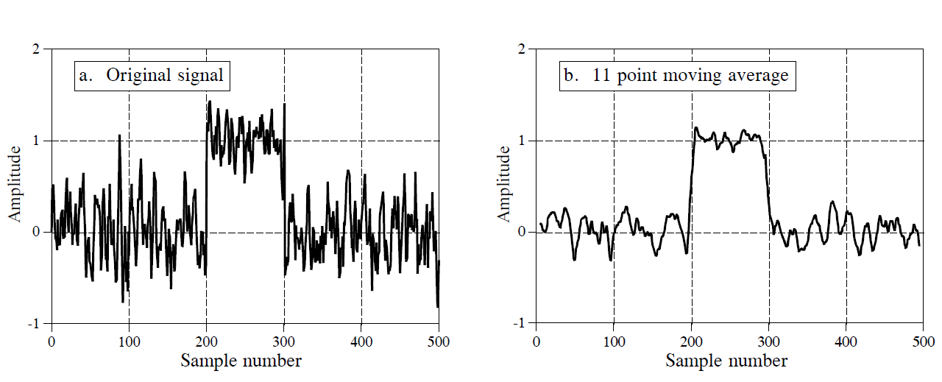
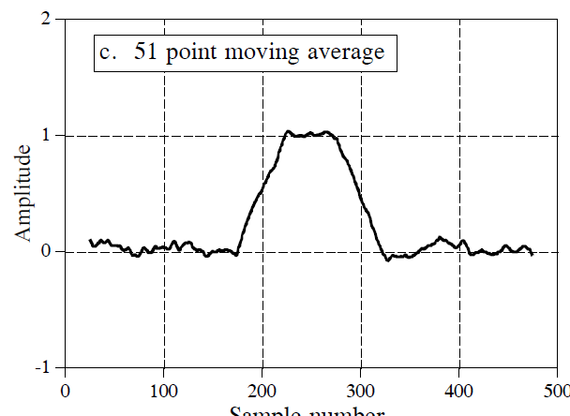
Noise reduction vs Step Response
The first signal is the input buried under a lot of noise. Applying moving average filter to this signal reduces noise(good) but decreases sharpness of edges(bad). Hence there is a tradeoff between sharpness and noise reduction. To understand why this filter is optimal solution for noise reduction for a given sharpness of edge(suppose that step response must have 11 points in it), imagine a signal obtained above as input. Since the noise we are trying to reduce is random, none of the input points is special; each is just as noisy as its neighbor. Therefore, it is useless to give preferential treatment to any one of the input points by assigning it a larger coefficient in the filter kernel. The lowest noise is obtained when all the input samples are treated equally, i.e., the moving average filter.

Slide 13
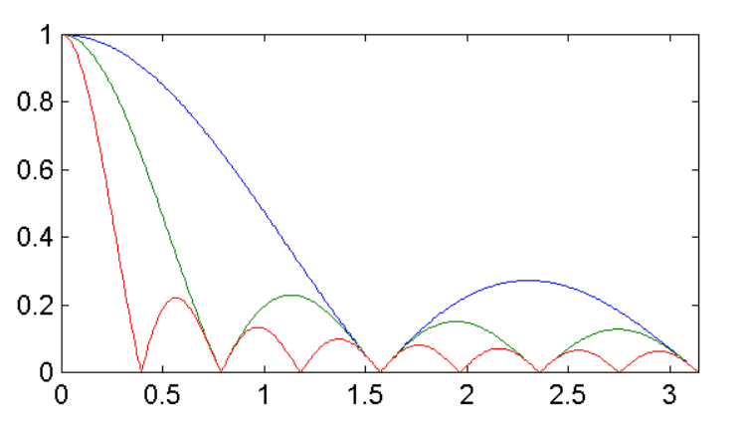
Frequency Response
When moving average filter is applied over any signal the following expression comes out:
H[f] = sin(πMf)/(Msin(πf)).
The roll-off is very slow and the stopband attenuation is ghastly. Clearly, moving average filter cannot separate one band of frequencies from another. Remember, good performance in the time domain results in poor perform- ance in frequency domain, and vice versa. If we were to design a low-pass filter than we haven’t done much as some of the higher frequencies are attenuated by a factor of 1/10.

Slide 14
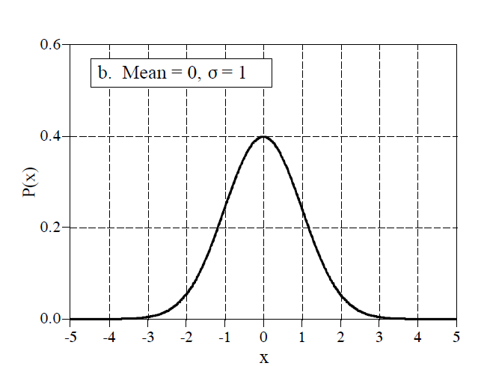
Gaussian Distribution
Signals formed from natural random processes usually have a bell shaped pdf. This is called a normal distribution. The basic shape of this curve is given by the following equation:
y = e^{−x^2}
An interesting property of this distribution is that its tail drops very rapidly as compared to other distributions. This is why a normally distributed signal has approximate peak-to-peak values in its graph. The cumulative distribution function of gaussian is obtained by num- erical methods and not by conventional integration techniques.

Slide 15
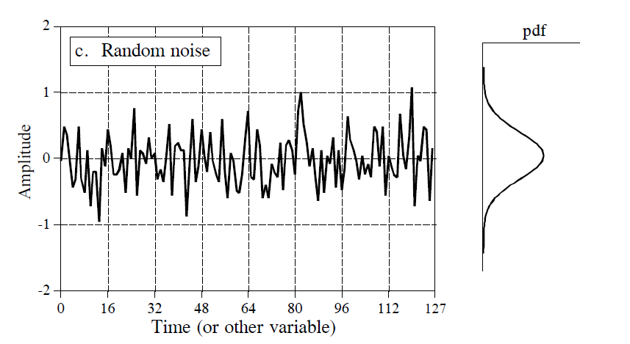
Digital Noise Generation
Random noise is an important topics in digital sig- nal processing. A common need in DSP is to genera- te signal resembling random noise. This is required to test whether algorithms work well under natural conditions or not. The heart of noise generation is random number generator. This function would randomly generate any number. And we want this generation to be gaussian type.

Slide 16

Can you guess how?

Slide 17
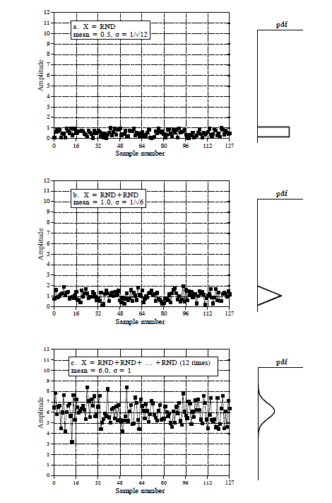
Central Limit Theorem
If we have a random number generator, generating numbers under uniform distribution then addition of two would generate a triangu- lar pulse. Doing this iteratively many times would generate a gauss- ian distribution by the central limit theorem, which says:
In probability theory, the central limit theorem (CLT) establishes that, in some situations, when independent random variables are added, their properly normalized sum tends toward a normal distribution (informally a "bell curve") even if the original variables themselves are not normally distributed.

Slide 18
Hope You Enjoyed

